Slide 1

Module 2: Software Development Life Cycle (SDLC)
Comprehensive concepts, foundational phases, deliverables, and enterprise advantages of engineering robust software systems.
Course: ITIT-3103 Software Engineering | Department: Information Technology
Institution: ABV-IIITM Gwalior | Instructor: Dr. Dheeraj Kodati

Slide 2

Part I: Introduction to SDLC
Defining the bedrock framework for software engineering excellence.

Slide 3
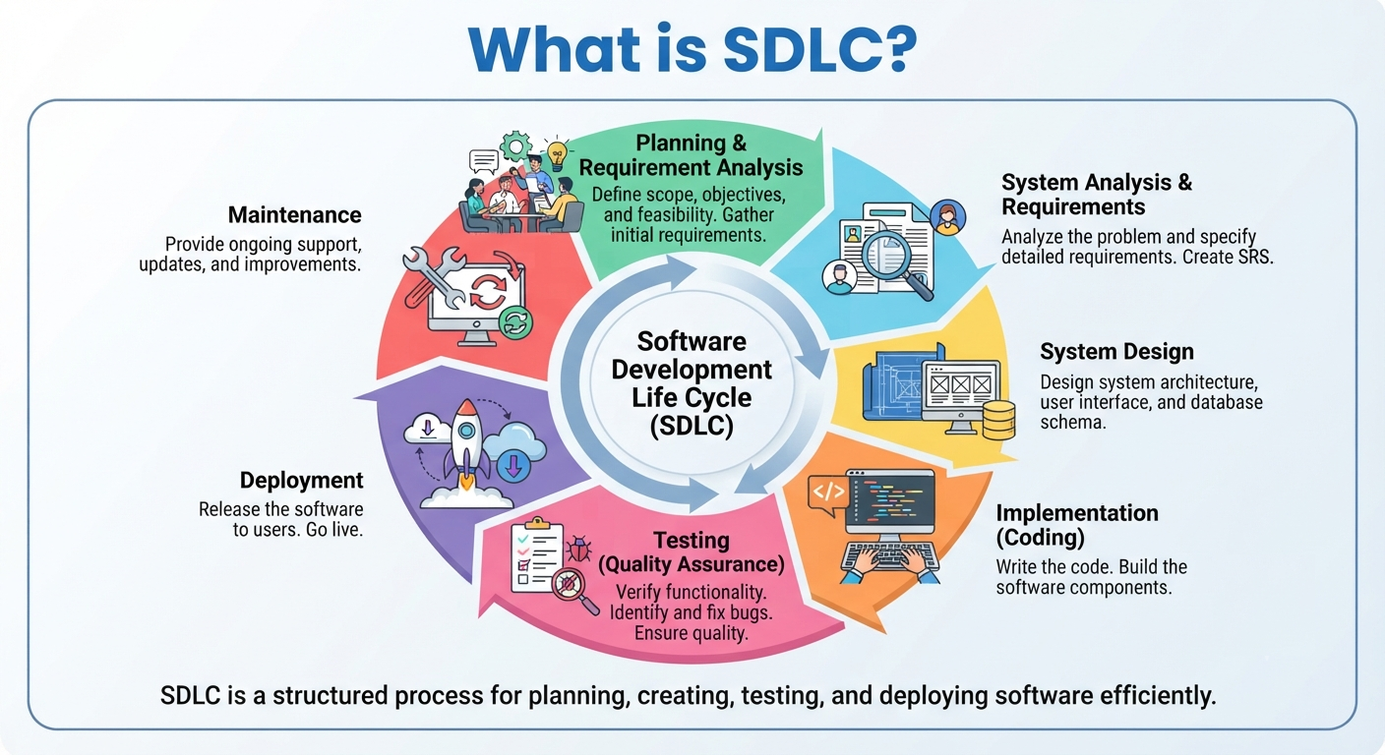

What is SDLC?
Software Development Life Cycle (SDLC) is a structured process and framework used by software teams to design, develop, test, and deploy high-quality software applications.
•
Standardizes workflow steps to eliminate guesswork.
•
Ensures alignment between business expectations and technical outputs.
•
Improves overall product quality, cost predictability, and delivery speed.

Slide 4






Why Do We Need SDLC?
Clarity & Direction
Risk Mitigation
Stakeholder Alignment
Provides a clear roadmap, milestone checks, and predictable execution paths for developers and project managers alike.
Identifies bottlenecks, security gaps, and architectural flaws early before they inflate rework costs exponentially.
Keeps clients, end-users, and engineering teams fully synchronized throughout every stage of building the software.

Slide 5
Part II: The 7 Phases of SDLC
From initial conceptualization to ongoing maintenance and retirement.

Slide 6
The 7 Core Phases at a Glance
Requirement Gathering & Analysis: Extracting core functional and business needs from stakeholders.
System Analysis: Feasibility studies and detailed modeling of data flows.
Design: Crafting system architecture, UI/UX layouts, and database schemas.
Implementation (Coding): Writing clean, maintainable source code in chosen tech stacks.
Testing: Rigorous unit, integration, and user-acceptance testing for bug elimination.
Deployment: Releasing code safely into live production environments.
Maintenance: Continuous patch management, optimization, and feature enhancements.

Slide 7

Phase 1: Requirements Gathering
The foundation of any successful project. Teams work closely with clients and business analysts to document what the software must achieve.
•
Functional Requirements: Features, data inputs, and specific business logic.
•
Non-Functional Requirements: Performance benchmarks, scalability bounds, and security parameters.
•
Gathering Methods: Interviews, surveys, focus groups, and workflow audits.

Slide 8
Deliverables: Requirements Phase
Deliverable Document | Primary Purpose | Target Audience
SRS Document (Software Requirements Specification) | Defines complete functional & non-functional expectations precisely. | Clients, Developers, QA Engineers
Use Case Specifications | Illustrates user-system interactions across distinct scenarios. | UX Designers, Developers
Requirements Traceability Matrix (RTM) | Maps user requirements to test cases to guarantee zero omission. | Project Managers, QA Leads

Slide 9
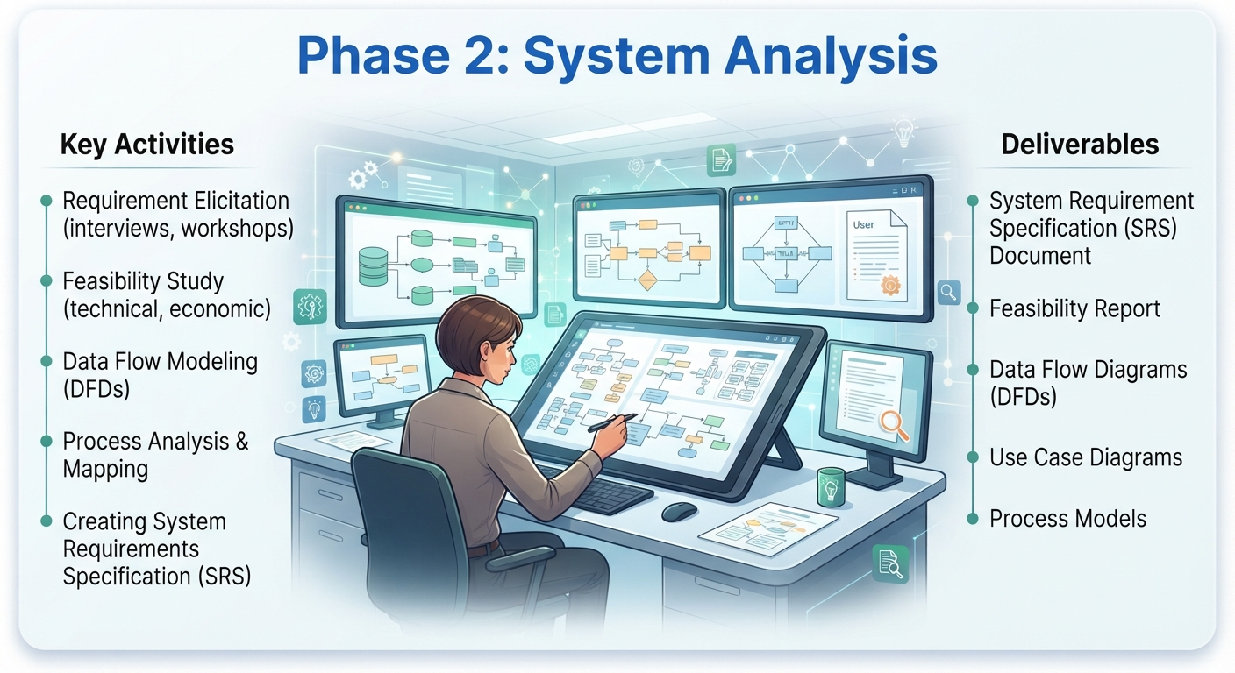
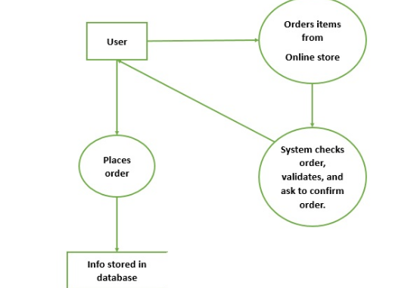
Phase 2: System Analysis
Evaluating the gathered requirements through deep technical and economic lenses to determine project viability.
•
Technical Feasibility: Do our tools and technologies support this vision?
•
Economic Feasibility: Is the ROI justifiable against development budgets?
•
Operational Feasibility: Can the organization adopt and maintain this system?

Slide 10
Deliverables: Analysis Phase
Deliverable Artefact | Description & Significance
Feasibility Report | Comprehensive study detailing financial, technical, and operational viability.
Data Flow Diagrams (DFDs) | Visual models mapping information inputs, data storage nodes, and output channels.
Entity-Relationship (ER) Models | Conceptual data models outlining core database tables and entity associations.

Slide 11
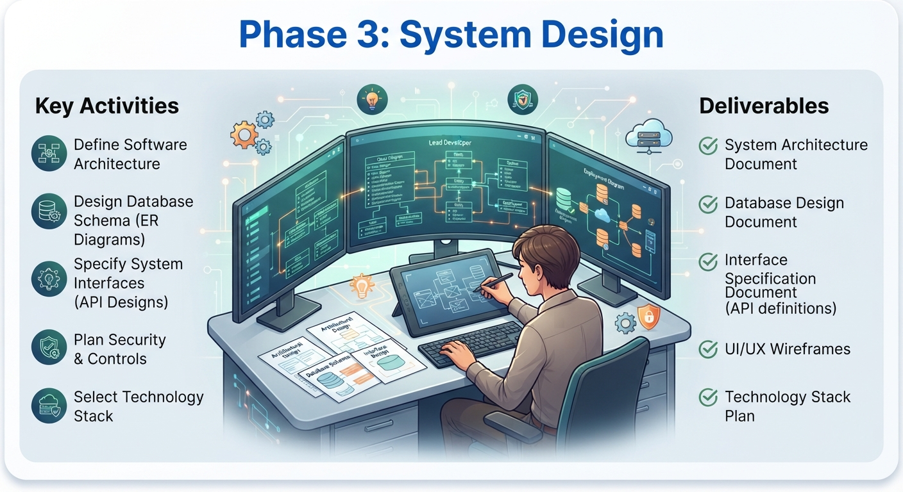
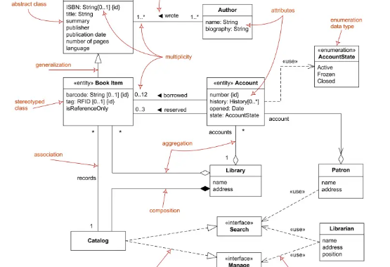
Phase 3: System Design
Translating business specifications into structural blueprints that guide software construction.
•
High-Level Design (HLD): Architecture overview, component relationships, server topology.
•
Low-Level Design (LLD): Detailed class diagrams, algorithms, data structures, and APIs.
•
UI/UX Wireframing: User interface mockups ensuring optimal user experiences.

Slide 12
Deliverables: Design Phase
Design Document | Scope & Specifications
HLD Document | System architecture, subsystem interaction matrices, and hosting setups.
LLD Document | Algorithm designs, database schema definitions, and class specifications.
UI/UX Prototypes | Interactive wireframes and style guides approved by stakeholders.

Slide 13
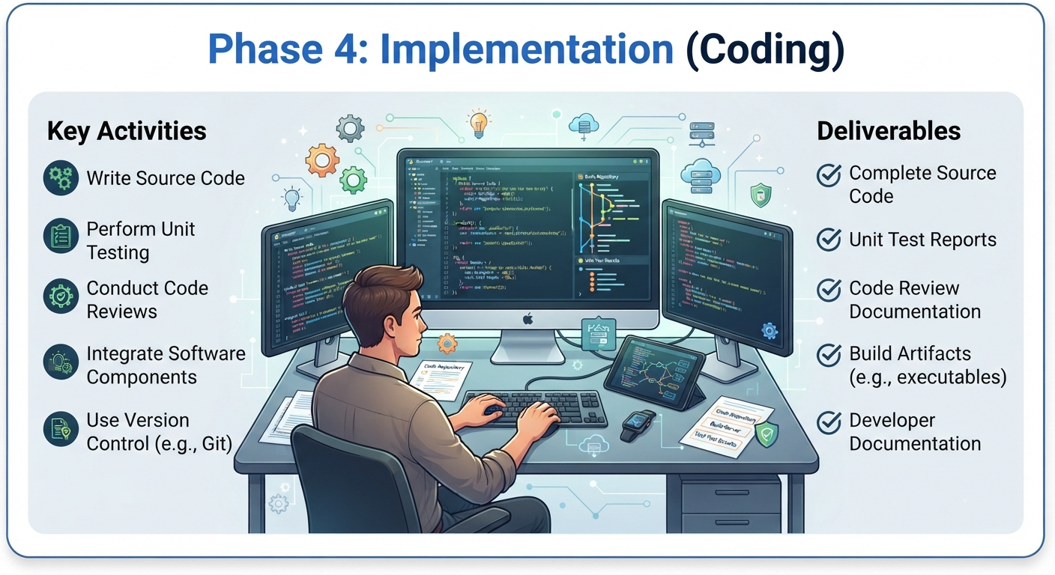
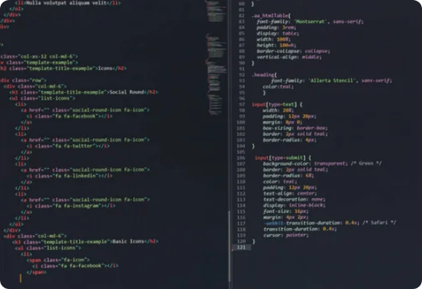
Phase 4: Implementation (Coding)
Developers write actual source code based on the approved design specifications, bringing the blueprint to life.
•
Adherence to strict coding standards and style guides.
•
Version control systems (e.g., Git) utilization for collaborative development.
•
Writing self-documenting code and performing developer unit checks.

Slide 14
Deliverables: Implementation Phase
Implementation Output | Description
Source Code Repository | Clean, production-ready modular code committed to version control.
Unit Test Scripts | Automated scripts verifying individual function and method correctness.
Build Packages | Compiled binaries or deployable packages ready for testing staging.

Slide 15
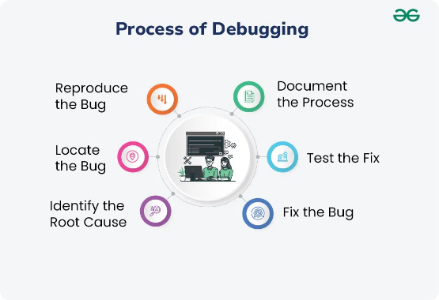
Phase 5: Testing
Ensuring software is robust, secure, and bug-free before releasing it to real users.
•
Unit Testing: Testing individual modules independently.
•
Integration Testing: Checking interactions between coupled subsystems.
•
System & UAT: Validating full performance against original business requirements.

Slide 16
Deliverables: Testing Phase
Testing Artifact | Purpose
Test Case Documentation | Detailed scripts covering test scenarios, expected outputs, and actual outcomes.
Bug / Defect Reports | Logs tracking software anomalies, severity levels, and resolution status.
Test Summary Report | Quality sign-off metric report confirming system readiness for release.

Slide 17
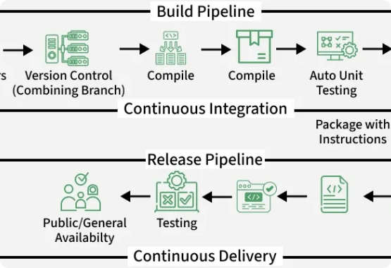
Phase 6: Deployment
Releasing the verified software application into the production environment for end-user consumption.
•
Automated CI/CD deployment pipelines (e.g., Jenkins, GitHub Actions).
•
Staged rollouts (Canary releases, blue-green deployment strategies).
•
User onboarding, training materials, and release note publication.

Slide 18
Deliverables: Deployment Phase
Deployment Asset | Description
Production-Ready Release | Fully installed software system operating on live client infrastructure.
User Manuals & Guides | Documentation assisting end-users and administrators in operating the system.
Deployment Runbook | Step-by-step technical procedures for future rollouts or rollbacks.

Slide 19
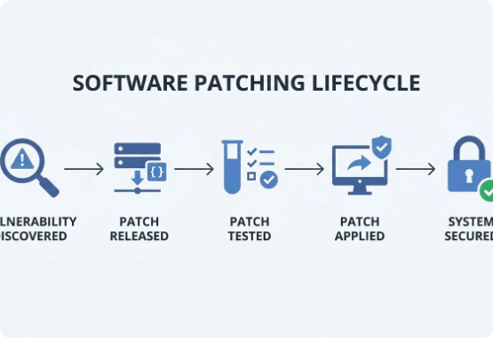
Phase 7: Maintenance
Ongoing support and evolution of the software post-release to ensure continuous operational excellence.
•
Corrective Maintenance: Fixing newly discovered bugs or hotfixes.
•
Adaptive Maintenance: Updating software to match new OS or hardware environments.
•
Perfective Maintenance: Adding new features and optimizing performance.

Slide 20
Deliverables: Maintenance Phase
Maintenance Output | Description
Patch Releases & Updates | Code fixes, security upgrades, and service packs.
Change Request Logs | Documentation recording requested enhancements and bug fixes over time.
Performance Audit Reports | Periodic evaluations tracking system uptime, speed, and reliability.

Slide 21
Part III: Advantages of SDLC
Why structured life cycles empower high-performing engineering organizations.

Slide 22



Key Advantages of SDLC
Cost Efficiency
On-Time Delivery
Enhanced Quality
Catching defects in the requirements or design phase prevents exponentially higher bug-fix costs during production.
Structured milestones, clear schedules, and rigorous planning eliminate severe project delays and scope creep.
Mandatory testing phases and rigorous documentation ensure the final application is stable, secure, and reliable.

Slide 23
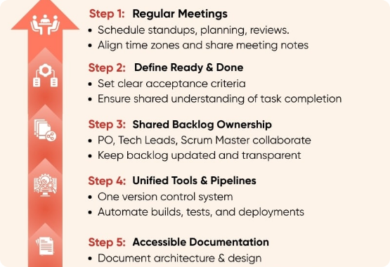
Organizational Benefits
•
Complete Visibility: Management and clients enjoy transparent progress tracking through clear phase gates.
•
Standardized Documentation: Ensures seamless staff transitions and knowledge transfer if team members leave.
•
Scalability: Establishes repeatable blueprints that can scale across multi-team enterprise projects.

Slide 24
Module 2 Summary
SDLC provides a disciplined engineering blueprint for turning complex business ideas into secure software.
The 7 core phases (Requirements, Analysis, Design, Implementation, Testing, Deployment, Maintenance) cover the complete software lifecycle.
Rigorous deliverables in each phase guarantee accountability, traceability, and high product quality.

Slide 25
Questions & Answers
Thank you! Let's discuss any queries regarding Module 2: SDLC.

Slide 26






Image Sources
https://static.vecteezy.com/system/resources/thumbnails/011/731/307/small/project-management-strategic-plan-to-manage-resources-for-development-working-process-and-schedule-task-completion-concept-smart-businessman-project-manager-manage-multiple-project-dashboards-nt-vector.jpg
Source: www.vecteezy.com
https://www.tutorialspoint.com/system_analysis_and_design/images/data_flow_diagram.jpg
Source: www.tutorialspoint.com
https://vfunction.com/wp-content/uploads/2025/01/uml-class-diagrams.webp
Source: vfunction.com
https://st2.depositphotos.com/57219478/50283/i/450/depositphotos_502836204-stock-photo-developer-python-java-script-html.jpg
Source: www.everypixel.com
https://media.geeksforgeeks.org/wp-content/uploads/20240612131318/Process-of-Debugging-.webp
Source: www.geeksforgeeks.org
https://media.geeksforgeeks.org/wp-content/uploads/20250821153350614262/cicd12.webp
Source: www.geeksforgeeks.org

Slide 27


Image Sources
https://tuxcare.com/wp-content/uploads/2026/05/software-patching-lifecycle.png.webp
Source: tuxcare.com
https://www.congruentsoft.com/images/blog-images/offshore/key-steps-to-agile-success-in-distributed-teams.jpg
Source: www.congruentsoft.com

